Slide 1
Modelling causality

Slide 2
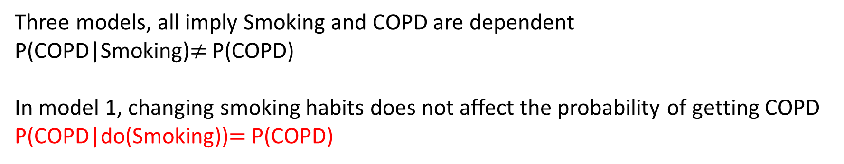
Reminder: Association is not Causality
Gene X
Gene X
Smoking
COPD
Smoking
COPD
Smoking
COPD
Three models, all imply Smoking and COPD are dependent
P(COPD|Smoking)$≠$ P(COPD)
In model 1, changing smoking habits does not affect the probability of getting COPD
P(COPD|do(Smoking))$=$ P(COPD)

Slide 3
In this lecture
Model causality using graphs
What can we do with a causal graph
D-separation for identifying dependencies and independencies.
Probabilistic Inference:
Variable elimination.
Causal Inference.
Do-calculus.

Slide 4
Modeling causality
Smoking causes CVD directly (in the context of measured variables)
Smoking
Recipe for creating a causal graph:
Model variables as graph nodes.
Add directed edges corresponding to direct causation.
Yellow Teeth
CVD

Slide 5
Modeling Causality
Smoking
Gene X (not in you model)
For this lecture:
No hidden common causes (causal sufficiency).
No causal feedback.
Causal structure is described by a Directed Acyclic Graph (DAG).
Yellow Teeth
CVD
Smoking
Yellow Teeth
CVD
Not allowed (yet)

Slide 6
Modeling Interventions
Ideal Interventions: You completely set the value/distribution of a variable.
e.g. assign to treatment/placebo group
The type of intervention you would typically like to do, not always possible.
fat-hand interventions affect more than one variable at a time.
sometimes a result of bad experimental design.
Smoking
Yellow Teeth
CVD

Slide 7
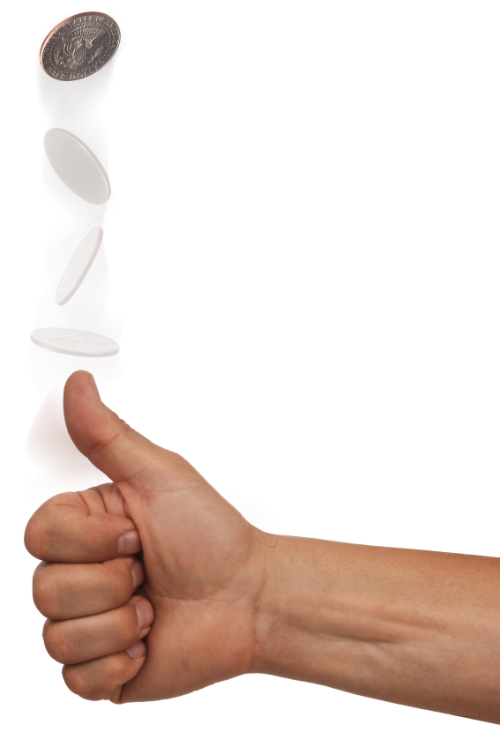
Modeling Interventions
Intervening on the cause:
You force half your sample to smoke, ban the rest from smoking.
More smokers than non-smokers have yellow teeth.
Smoking
Yellow Teeth
CVD

Slide 8
Modeling Interventions
Intervening on the effect:
You stain half your sample’s teeth yellow, you whiten the teeth of the rest.
Smokers do not have yellow teeth more than non-smokers.
Smoking
Yellow Teeth
CVD

Slide 9
Modeling Interventions
Graph Surgery/do operator removes all edges that are incoming to the manipulated variable.
Causal relationships are now described by the manipulated graph.
Smoking
Yellow Teeth
CVD

Slide 10

Modeling probabilistic causality
Graph $G$ captures the qualitative causal relations
JPD $J$encodes the quantitative probabilistic properties
Smoking causes CVD directly (in the context of measured variables)
Smoking
What connects the two?
 |  | CVD
Yellow Teeth | Smoking | Y | N
Y | Y | 0.17 | 0.06 | 0.13
N | Y | 0.06 | 0.02 | 0.08
Y | N | 0.02 | 0.06 | 0.08
N | N | 0.15 | 0.46 | 0.61
 |  | 0.4 | 0.6 | 1
Yellow Teeth
CVD

Slide 11
Causal Markov Condition
Graph $G$ captures the qualitative causal relations
JPD $J$encodes the quantitative probabilistic properties
Smoking
 |  | CVD
Yellow Teeth | Smoking | Y | N
Y | Y | 0.17 | 0.06 | 0.13
N | Y | 0.06 | 0.02 | 0.08
Y | N | 0.02 | 0.06 | 0.08
N | N | 0.15 | 0.46 | 0.61
 |  | 0.4 | 0.6 | 1
Yellow Teeth
CVD
Causal Markov Condition (CMC):
Every variable is independent of its non-effects (non-descendants in the graph) given its direct causes (parents).

Slide 12
Causal Markov Condition
Graph $G$ captures the qualitative causal relations
JPD $J$encodes the quantitative probabilistic properties
Smoking
 |  | CVD
Yellow Teeth | Smoking | Y | N
Y | Y | 0.17 | 0.06 | 0.13
N | Y | 0.06 | 0.02 | 0.08
Y | N | 0.02 | 0.06 | 0.08
N | N | 0.15 | 0.46 | 0.61
 |  | 0.4 | 0.6 | 1
Yellow Teeth
CVD
CVD and yellow teeth are dependent, but become independent once you know if a person smokes.
Causal Markov Condition (CMC):
Every variable is independent of its non-effects (non-descendants in the graph) given its direct causes (parents).
Learning the value of intermediate and common causes renders variables independent.

Slide 13
Causal Markov Condition and the JPD
P(Smoking, Yellow Teeth, CVD) =
Smoking
Yellow Teeth
CVD
Notes:
The causal markov condition can be used to factorthe graph

Slide 14
Causal Markov Condition and the JPD
P(Smoking, Yellow Teeth, CVD) =
P(Smoking) ×
P(Yellow Teeth | Smoking ) ×
P(CVD | Smoking, Yellow Teeth)
Smoking
Yellow Teeth
CVD
By the chain rule of probability.
Notes:
The causal markov condition can be used to factorthe graph

Slide 15
Causal Markov Condition and the JPD
P(Smoking, Yellow Teeth, CVD) =
P(Smoking) ×
P(Yellow Teeth | Smoking ) ×
P(CVD | Smoking, Yellow Teeth)
Smoking
Yellow Teeth
CVD
By the CMC:
P(CVD|Smoking, Yellow Teeth) = P(CVD|Smoking).
Notes:
The causal markov condition can be used to factorthe graph

Slide 16
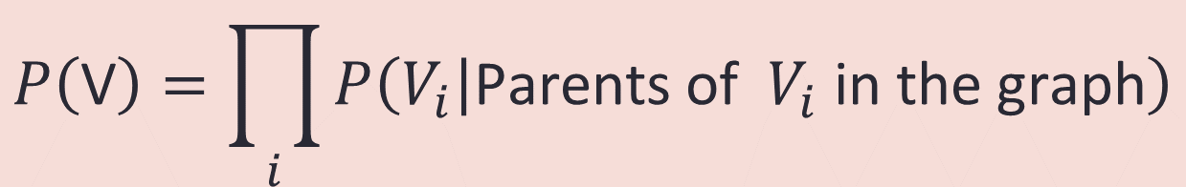
Factorization with the CMC
P(Smoking, Yellow Teeth, CVD) =
P(Smoking) ×
P(Yellow Teeth | Smoking ) ×
P(CVD | Smoking)
Smoking
Yellow Teeth
CVD
$$P\left(\text{V}\right)=\prod_{i}{P\left(\left.V_{i}\right|\text{Parents} \text{of} V_{i} \text{in} \text{the} \text{graph}\right)}$$
In general:

Slide 17
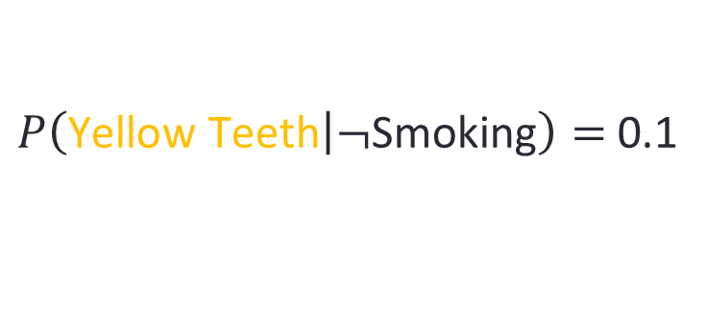

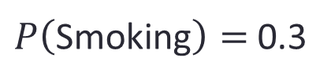
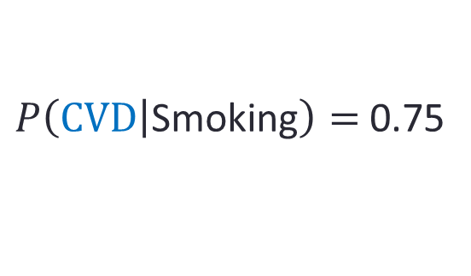
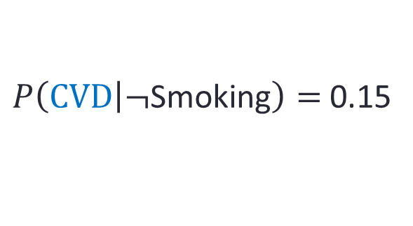
Causal Bayesian Network
Smoking
$P\left(\text{Smoking}\right)=$0.3
Yellow Teeth
CVD
$P\left(\left.\text{Yellow} \text{Teeth}\right|\text{Smoking}\right)=$ 0.85
$P\left(\left.CVD\right|\text{Smoking}\right)=$0.75
$P\left(\left.\text{Yellow} \text{Teeth}\right|¬\text{Smoking}\right)=$ 0.1
$P\left(\left.CVD\right|¬\text{Smoking}\right)=$ 0.15
Causal DAG and conditional probability tables define a Causal Bayesian Network

Slide 18
Factorization with the CMC
Before CMC
After CMC
P(Smoking, Yellow Teeth, CVD) =
P(Smoking) ×
P(Yellow Teeth | Smoking ) ×
P(CVD | Smoking, Yellow Teeth)
P(Smoking, Yellow Teeth, CVD) =
P(Smoking) ×
P(Yellow Teeth | Smoking ) ×
P(CVD | Smoking, Yellow Teeth)
1
1
2
2
4
2
Number of parameters for binary variables
1+2+4 = 7
1+2+2 = 5
Notes:
The causal markov condition can be used to factorthe graph

Slide 19
Factorization with the CMC
Assume n binary variables with k parents each.
^{k}
…

Slide 20
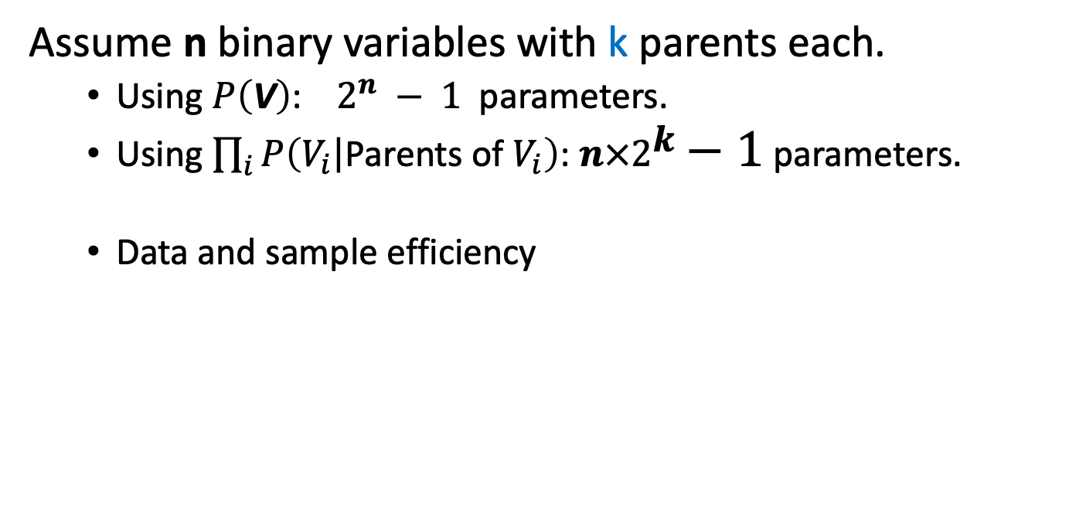
Factorization with the CMC
Assume n binary variables with k parents each.
Using $P\left(\text{V}\right)$: $2^{n} − 1$parameters.
Using $\prod_{i}{P\left(\left.V_{i}\right|\text{Pa}\text{rents} \text{of} V_{i}\right)}$: $n×2^{k}−1$ parameters.
Data and sample efficiency
^{k}
…

Slide 21
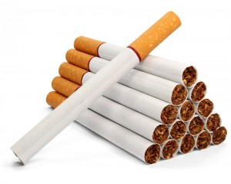
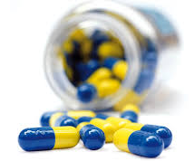
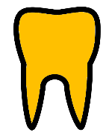

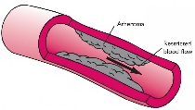
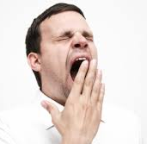
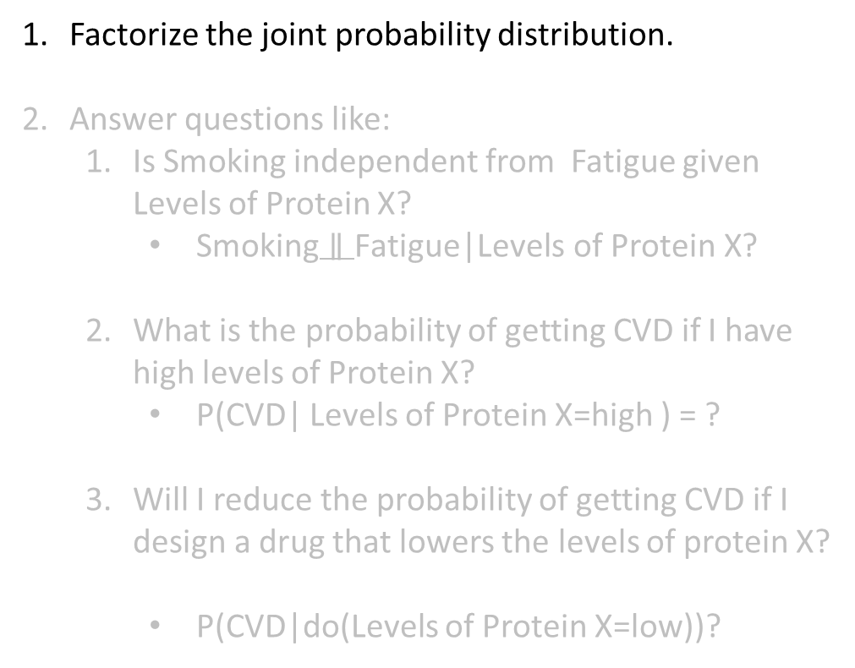
Things you can do with a Causal Bayesian Network
Factorize the joint probability distribution.
Answer questions like:
Is Smoking independent from Fatigue given Levels of Protein X?
$\text{Smoking}∥\text{Fatigue}\text{|}\text{Levels} \text{of} \text{Protein} \text{X}\text{?}$
What is the probability of getting CVD if I have high levels of Protein X?
P(CVD| Levels of Protein X=high ) = ?
Will I reduce the probability of getting CVD if I design a drug that lowers the levels of protein X?
P(CVD|do(Levels of Protein X=low))?
Smoking
Medicine Y
Yellow
Teeth
Levels of Protein X
CVD
Fatigue

Slide 22
CMC and conditional independencies
Smoking
Medicine Y
Every variable is independent of its non-effects given its direct causes.
Yellow
Teeth
Levels of Protein X
CVD
Fatigue

Slide 23
CMC and conditional independencies
Smoking
Medicine Y
CVD is independent of its non-effects given Levels of Protein X.
Yellow
Teeth
Levels of Protein X
CVD
Fatigue

Slide 24
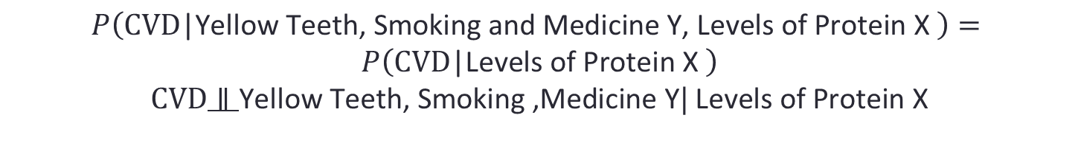
CMC and conditional independencies
Smoking
Medicine Y
CVD is independent of Yellow Teeth, Smoking, Medicine Y given Levels of Protein X.
Yellow
Teeth
Levels of Protein X
CVD
Fatigue
$$P\left(CVD\text{|}\text{Yellow} \text{Teeth}\text{, }\text{Smoking} \text{and} \text{Medicine} \text{Y}\text{, }\text{Levels} \text{of} \text{Protein} \text{X} \right)=$$
$$P\left(CVD\text{|}\text{Levels} \text{of} \text{Protein} \text{X} \right)$$
$CVD∥\text{Yellow} \text{Teeth}\text{, }\text{Smoking}\text{ ,}\text{Medicine} \text{Y}|$ $\text{Levels} \text{of} \text{Protein} \text{X}$

Slide 25
Querying CMC
Smoking
Medicine Y
Is Fatigue independent from smoking given CVD?
Yellow
Teeth
Levels of Protein X
CVD
Fatigue

Slide 26
Querying CMC
Smoking
Medicine Y
Fatigue is independent of its non-effects given its direct causes.
Yellow
Teeth
Levels of Protein X
CVD
Fatigue

Slide 27
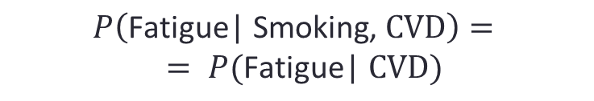
Querying CMC
Smoking
Medicine Y
Fatigue is independent of Smoking given CVD .
Yellow
Teeth
Levels of Protein X
CVD
Fatigue
$$P\left(\text{Fatigue}\text{| }\text{Smoking}\text{, }CVD\right)=$$
$$= P(\text{Fatigue}\text{| }CVD)$$

Slide 28
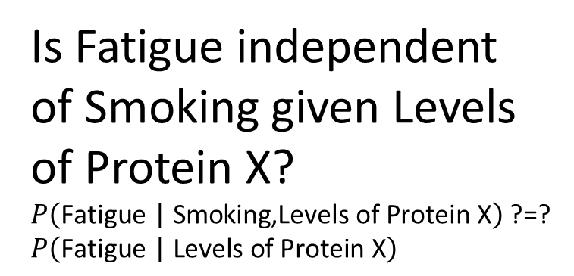
Querying CMC
Smoking
Medicine Y
Is Fatigue independent of Smoking given Levels of Protein X?
$P\left(\text{Fatigue}\text{ | }\text{Smoking}\text{,} \text{Levels} \text{of} \text{Protein} \text{X}\right)$ ?=? $P\left(\text{Fatigue}\text{ | }\text{Levels} \text{of} \text{Protein} \text{X}\right)$
Yellow
Teeth
Levels of Protein X
CVD
Fatigue

Slide 29
Querying CMC
Smoking
Medicine Y
Is Fatigue independent of Smoking given Levels of Protein X?
$P\left(\text{Fatigue}\text{ | }\text{Smoking}\text{,} \text{Levels} \text{of} \text{Protein} \text{X}\right)$ ?=? $P\left(\text{Fatigue}\text{ | }\text{Levels} \text{of} \text{Protein} \text{X}\right)$
Yellow
Teeth
Levels of Protein X
CVD
?
Fatigue

Slide 30




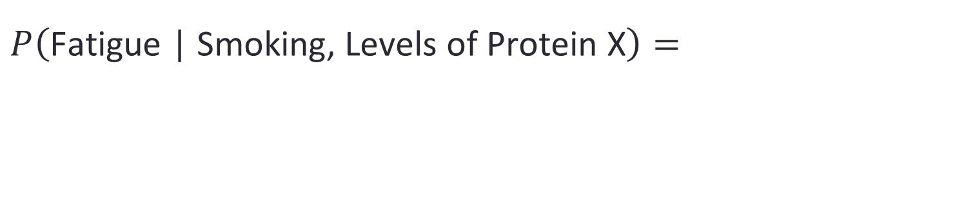
Do the math
$$P\left(\text{Fatigue}\text{ | }\text{Smoking}\text{,} \text{Levels} \text{of} \text{Protein} \text{X}\right)=$$
Smoking
Medicine Y
Yellow
Teeth
Levels of Protein X
CVD
Fatigue
You want to prove: $P\left(\text{Fatigue}\text{ | }\text{Smoking}\text{,} \text{Levels} \text{of} \text{Protein} \text{X}\right)$ = $P\left(\text{Fatigue}\text{ | }\text{Levels} \text{of} \text{Protein} \text{X}\right)$
Notes:
We can also use the cmc to reason with the graph

Slide 31
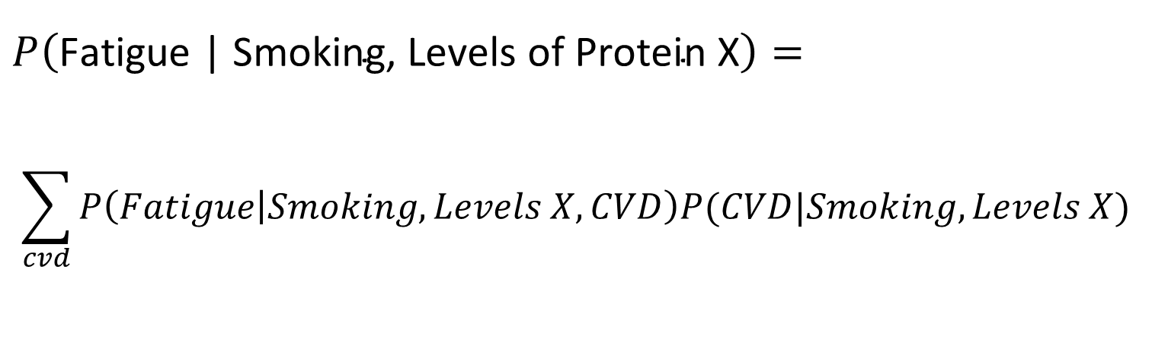
Do the math
$$P\left(\text{Fatigue}\text{ | }\text{Smoking}\text{,} \text{Levels} \text{of} \text{Protein} \text{X}\right)=$$
$$\sum_{cvd}{P\left(Fatigue | Smoking, Levels X, CVD\right)P(CVD|Smoking, Levels X)}$$
Smoking
Medicine Y
Yellow
Teeth
Levels of Protein X
CVD
Fatigue
Law of total probability.
Notes:
We can also use the cmc to reason with the graph

Slide 32
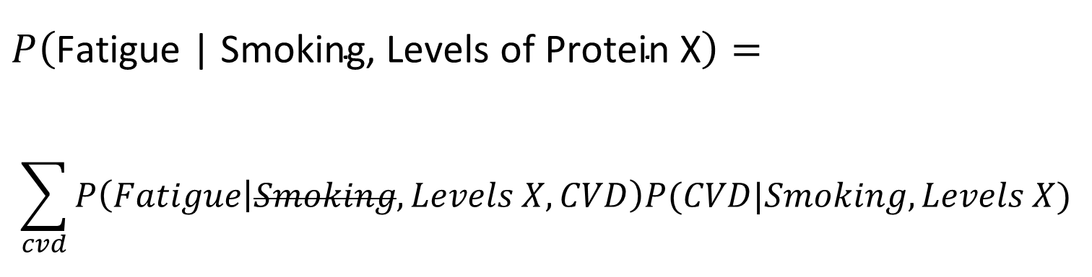
Do the math
$$P\left(\text{Fatigue}\text{ | }\text{Smoking}\text{,} \text{Levels} \text{of} \text{Protein} \text{X}\right)=$$
$$\sum_{cvd}{P\left(Fatigue | Smoking, Levels X, CVD\right)P(CVD|Smoking, Levels X)}$$
Smoking
Medicine Y
Yellow
Teeth
Levels of Protein X
CVD
Fatigue
The CMC: P(F|S, X, CVD) = P(F|X, CVD).
Notes:
We can also use the cmc to reason with the graph

Slide 33
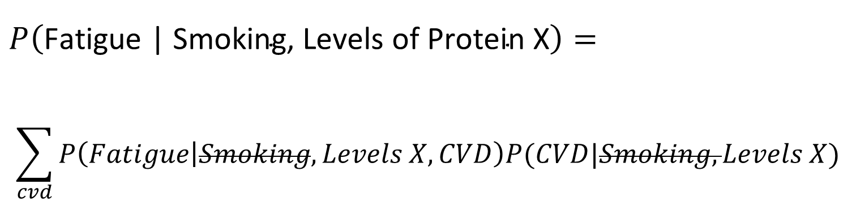
Do the math
$$P\left(\text{Fatigue}\text{ | }\text{Smoking}\text{,} \text{Levels} \text{of} \text{Protein} \text{X}\right)=$$
$$\sum_{cvd}{P\left(Fatigue | Smoking, Levels X, CVD\right)P(CVD|Smoking, Levels X)}$$
Smoking
Medicine Y
Yellow
Teeth
Levels of Protein X
CVD
Fatigue
The CMC: P(CVD|S, X) = P(CVD|X).
Notes:
We can also use the cmc to reason with the graph

Slide 34
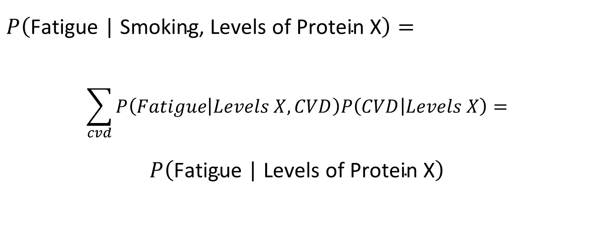
Do the math
$$P\left(\text{Fatigue}\text{ | }\text{Smoking}\text{,} \text{Levels} \text{of} \text{Protein} \text{X}\right)=$$
$$\sum_{cvd}{P\left(Fatigue | Levels X, CVD\right)P\left(CVD | Levels X\right)=}$$
$$P\left(\text{Fatigue}\text{ | }\text{Levels} \text{of} \text{Protein} \text{X}\right)$$
Smoking
Medicine Y
Yellow
Teeth
Levels of Protein X
CVD
Fatigue
Law of total Probability
Notes:
We can also use the cmc to reason with the graph

Slide 35

Do the math
$$P\left(\text{Fatigue}\text{ | }\text{Smoking}\text{,} \text{Levels} \text{of} \text{Protein} \text{X}\right)=$$
$$P\left(\text{Fatigue}\text{ | }\text{Levels} \text{of} \text{Protein} \text{X}\right)$$
Smoking
Medicine Y
Yellow
Teeth
Levels of Protein X
CVD
The Causal Markov condition dictates some independencies, entails some more.
Fatigue
Notes:
We can also use the cmc to reason with the graph

Slide 36
The d-separation criterion
Algorithm to determine all independencies entailed by the Causal Markov Condition.
Paths in the graph represent information flow (or lack thereof)

Slide 37
Example
P(B)
0.001
P(E)
0.002
Burglar
Earthquake
You have an installed alarm.
Burglars set off the alarm.
Earthquakes set of the alarm.
When the alarm goes off, one of your neighbors (John or Mary) may call you.
B | E | P(A)
T | T | 0.95
T | F | 0.94
F | T | 0.29
F | F | 0.001
Alarm
A | P(JC)
T | 0.7
F | 0.2
A | P(MC)
T | 0.85
F | 0.4
John Calls
Mary Calls
Example by J. Pearl

Slide 38

Causal Chains
Burglar
Earthquake
A causal path is an open path (it allows information to flow).
Alarm
John Calls
Mary Calls
When your house is being robbed, the probability of getting a phone call from John is higher than usual (due to the alarm going off).
$$\text{Burglar}∦\text{John} \text{Calls}|∅$$

Slide 39
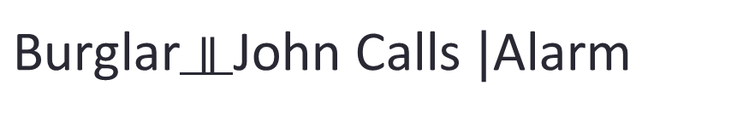
Causal Chains
Burglar
Earthquake
Conditioning on intermediate causes blocks the path.
Alarm
John Calls
Mary Calls
If you know the alarm has gone off, whether this was due or not to a burglary does not change your belief about the probability of getting a phone call from John.
$\text{Burglar}∥\text{John} \text{Calls} |$Alarm

Slide 40

Causal Forks
Burglar
Earthquake
A path that goes through a common cause is an open path (it allows information to flow).
Alarm
John Calls
Mary Calls
When John calls you, the probability that Mary will also call you is higher than usual (because John usually calls when the alarm has gone off).
$$\text{John} \text{Calls}∦\text{Mary} \text{Calls} |∅$$

Slide 41
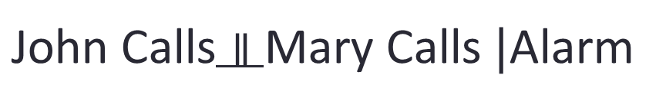
Causal Forks
Burglar
Earthquake
Conditioning on common causes blocks the path.
Alarm
John Calls
Mary Calls
$\text{John} \text{Calls}∥\text{Mary} \text{Calls} |$Alarm
If you know the alarm has gone off, whether John has called does not change your belief that Mary will call.

Slide 42
Chains and forks
Chains
Forks
Chains and forks are open
Conditioning on the middle node blocks them

Slide 43
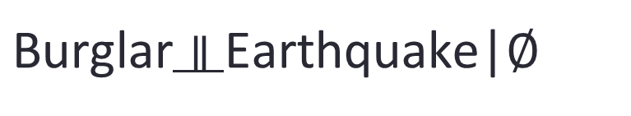
Colliders
Burglar
Earthquake
A path that goes through a common effect is a blocked path (no information flows).
Alarm
John Calls
Mary Calls
$\text{Burglar}∥\text{Earthquake}$|$∅$
Burglaries and earthquakes are not correlated.

Slide 44
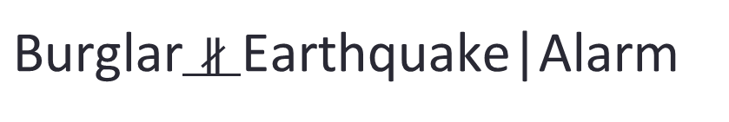
Colliders
Burglar
Earthquake
However, conditioning on common effects opens the path (information flows through the path.)
Alarm
John Calls
Mary Calls
$\text{Burglar}∦\text{Earthquake}$|$\text{Alarm}$
Your alarm has gone off. If there is also an earthquake, you think there is probably no burglary.

Slide 45
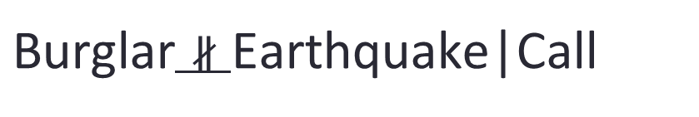
Colliders
However, conditioning on common (not necessarily direct) effects opens the path (information flows through the path).
Burglar
Earthquake
Alarm
John Calls
Mary Calls
$\text{Burglar}∦\text{Earthquake}$|$\text{Call}$
John is calling. If there is also an earthquake, you think there is probably no burglary.

Slide 46
Colliders
Colliders are blocked
Conditioning on (a descendant of ) the middle node opens them

Slide 47
(non) colliders
X
Z
X
Z
X
Z
X
Z
Y
Y
Y
Y
collider
non- collider
non- collider
non- collider
For a triple X-Y-Z:
The term is used to denote both the triplet and the middle node!
If both edges are into Y, the triplet (and Y) is a collider.
Otherwise the triplet (and Y) is a non-collider.

Slide 48
(non) colliders
X
Z
X
Z
X
Z
X
Z
Y
Y
Y
Y
collider
non- collider
non- collider
non- collider
A collider triplet is a blocked path
=> conditioning on Y (or a descendant of Y) opens the path.
A non-collider triplet is an open path
=> conditioning on Y blocks the path.

Slide 49

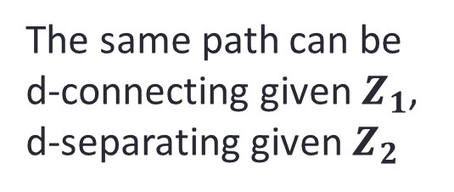
The d-separation criterion
Open (d-connecting) paths :
A path is d-connecting given Z iff
every collider on the path is in Z or has a descendant in Z
AND
every non-collider on the path is not in Z.
Otherwise, the path is blocked (d-separating).
The same path can be d-connecting given $Z_{1}$, d-separating given $Z_{2}$

Slide 50
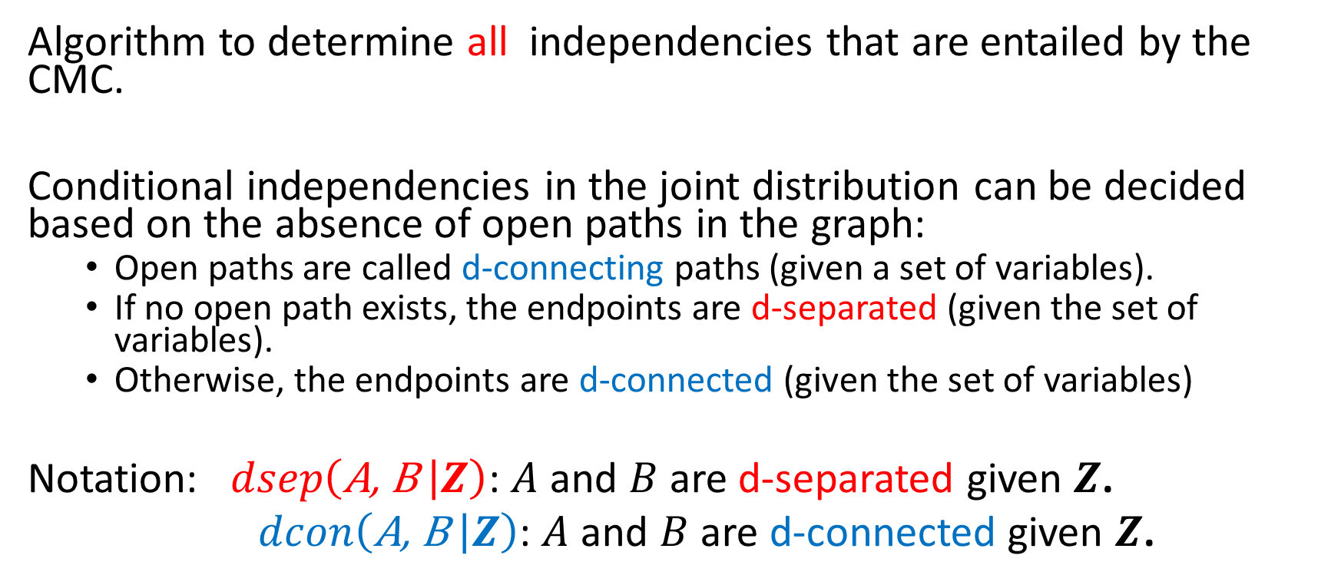
The d-separation criterion
Algorithm to determine all independencies that are entailed by the CMC.
Conditional independencies in the joint distribution can be decided based on the absence of open paths in the graph:
Open paths are called d-connecting paths (given a set of variables).
If no open path exists, the endpoints are d-separated (given the set of variables).
Otherwise, the endpoints are d-connected (given the set of variables)
Notation: $dsep\left(\text{A}\text{, }\text{B} | Z\right)$: $A$ and $B$ are d-separated given $Z$.
$dcon\left(\text{A}\text{, }\text{B} | Z\right)$: $A$ and $B$ are d-connected given $Z$.

Slide 51
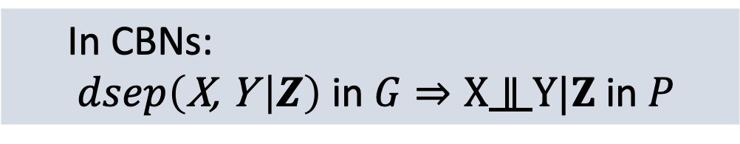

The d-separation criterion
To find if $dsep\left(\text{X}\text{, }\text{Y} | Z\right)$ in the graph:
Find the paths from X to Y (ignoring orientations).
If there exists no open path given Z, then $dsep(\text{X}\text{, }\text{Y} |Z)$.
Smoking
Medicine Y
Yellow
Teeth
Levels of Protein X
CVD
Fatigue
In CBNs:
$dsep\left(\text{X}\text{, }\text{Y} | Z\right)$ in $G⇒X∥Y|Z$ in $P$

Slide 52
The d-separation criterion
Smoking
Medicine Y
Is Fatigue independent of Smoking given Levels of Protein X?
Yellow
Teeth
Levels of Protein X
CVD
Fatigue

Slide 53
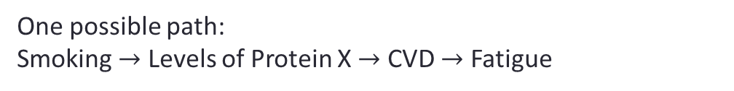
The d-separation criterion
Smoking
Medicine Y
Is Fatigue independent of Smoking given Levels of Protein X?
Yellow
Teeth
Levels of Protein X
CVD
One possible path:
Smoking $→$ Levels of Protein X $→$ CVD $→$ Fatigue
Fatigue
Path is blocked given Levels of Protein X

Slide 54
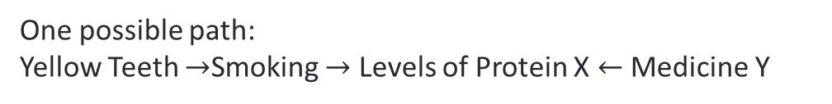
The d-separation criterion
Smoking
Medicine Y
Are Yellow Teeth independent of Medicine Υ?
Yellow
Teeth
Levels of Protein X
CVD
One possible path:
Yellow Teeth $→$Smoking $→$ Levels of Protein X $←$ Medicine Y
Fatigue
Path is blocked given the empty set (goes through a collider)

Slide 55
The d-separation criterion
Smoking
Medicine Y
Are Yellow Teeth independent of Medicine Υ given CVD?
Yellow
Teeth
Levels of Protein X
CVD
One possible path:
Yellow Teeth $→$Smoking $→$ Levels of Protein X $←$ Medicine Y
Fatigue
Path is open given the CVD (conditioning on the descendant of a collider)

Slide 56
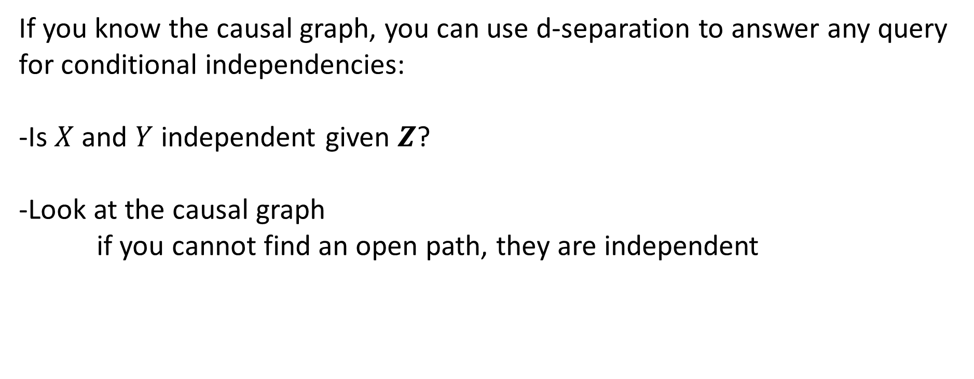
D-separation: overview
If you know the causal graph, you can use d-separation to answer any query for conditional independencies:
-Is $X$ and $Y$ independent given $Z$?
-Look at the causal graph
if you cannot find an open path, they are independent

Slide 57
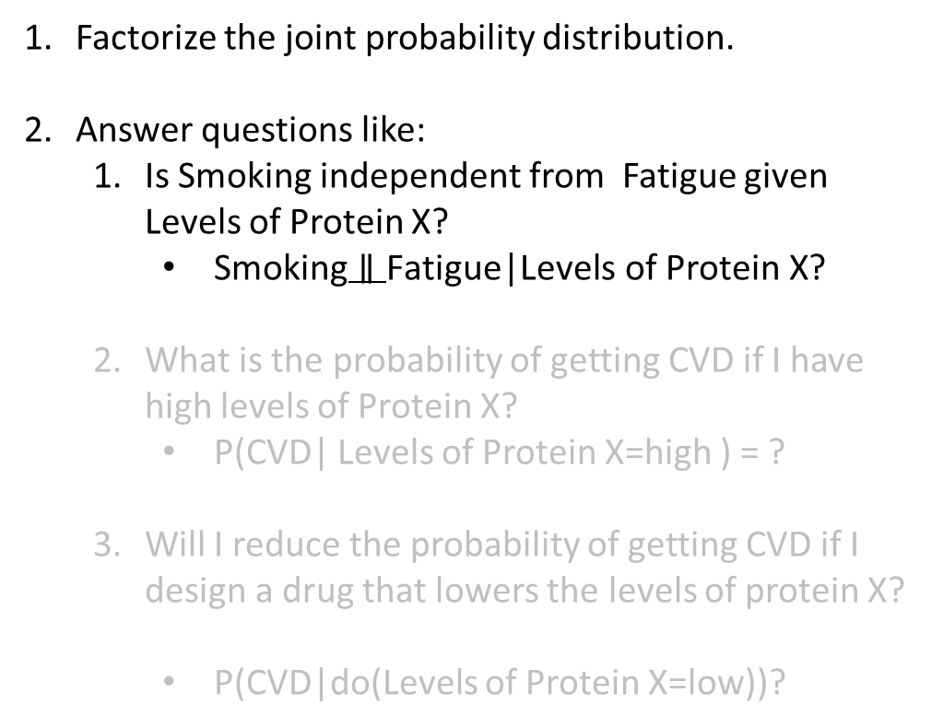
Things you can do with a Causal Bayesian Network
Factorize the joint probability distribution.
Answer questions like:
Is Smoking independent from Fatigue given Levels of Protein X?
$\text{Smoking}∥\text{Fatigue}\text{|}\text{Levels} \text{of} \text{Protein} \text{X}\text{?}$
What is the probability of getting CVD if I have high levels of Protein X?
P(CVD| Levels of Protein X=high ) = ?
Will I reduce the probability of getting CVD if I design a drug that lowers the levels of protein X?
P(CVD|do(Levels of Protein X=low))?
Smoking
Medicine Y
Yellow
Teeth
Levels of Protein X
CVD
Fatigue

Slide 58
Probabilistic Inference: Easy
You measure all covariates for a patient. (smoking, medicine y, yellow teeth, protein x)
What is the probability they have CVD?
Smoking
Medicine Y
Yellow
Teeth
Levels of Protein X
CVD
P(CVD| Levels of Protein X=high, Smoking=yes, Medicine Y = no, Yellow Teeth = yes ) = ?
Fatigue

Slide 59
Probabilistic Inference:
In general, probabilistic inference is NP-hard.
Exact algorithms can have better average-case performance, particularly for distributions where the integrals can be computed in closed form.
E.g., junction tree, belief propagation
Otherwise, approximate inference using Sampling/MCMC

Slide 60
Probabilistic Inference: Easy
You measure all covariates for a patient. (smoking, medicine y, yellow teeth, protein x)
What is the probability they have CVD?
Smoking
Medicine Y
Yellow
Teeth
Levels of Protein X
CVD
P(CVD| Levels of Protein X=high, Smoking=yes, Medicine Y = no, Yellow Teeth = yes ) =
P(CVD|Levels of Protein X)
Fatigue

Slide 61
Probabilistic Inference: Easy
You measure all covariates for a patient. (smoking, medicine y, yellow teeth, protein x)
What is the probability they have CVD?
Smoking
Medicine Y
Yellow
Teeth
Levels of Protein X
CVD
P(CVD| Levels of Protein X=high, Smoking=yes, Medicine Y = no, Yellow Teeth = yes ) =
P(CVD|Levels of Protein X)
Fatigue

Slide 62
Probabilistic Inference: Hard
You do not have measurements for protein X, you only know that a patient smokes and does not take medicine Y.
What is the probability they have CVD?
Smoking
Medicine Y
Yellow
Teeth
Levels of Protein X
CVD
P(CVD| Smoking=yes, Medicine Y = no) =
Fatigue

Slide 63
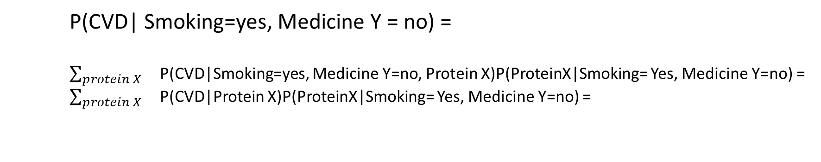
Probabilistic Inference: Hard
Smoking
Medicine Y
You do not have measurements for protein X, you only know that a patient smokes and does not take medicine Y.
What is the probability they have CVD?
Yellow
Teeth
Levels of Protein X
CVD
Fatigue
P(CVD| Smoking=yes, Medicine Y = no) =
$\sum_{protein X}{}$P(CVD|Smoking=yes, Medicine Y=no, Protein X)P(ProteinX|Smoking= Yes, Medicine Y=no) =
$\sum_{protein X}{}$P(CVD|Protein X)P(ProteinX|Smoking= Yes, Medicine Y=no) =

Slide 64
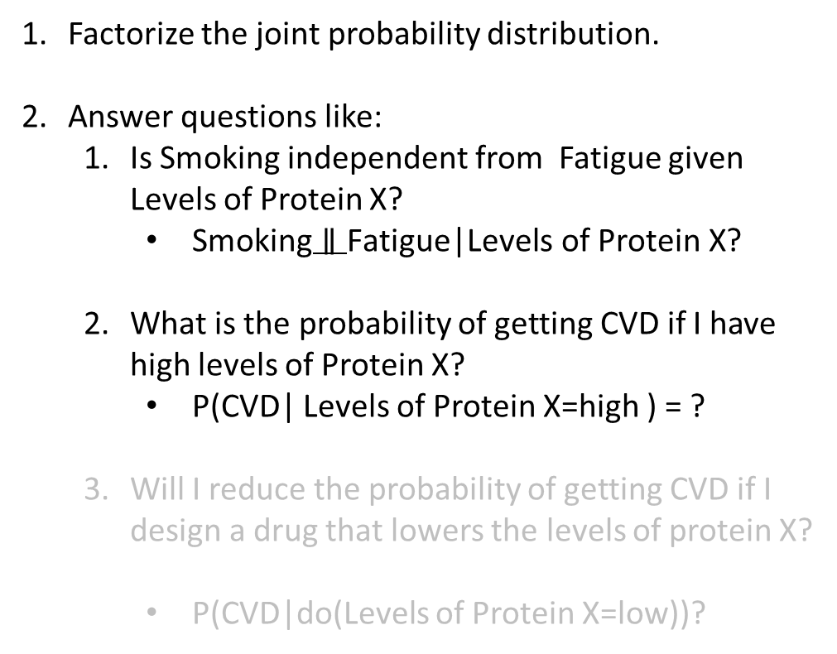
Things you can do with a Causal Bayesian Network
Factorize the joint probability distribution.
Answer questions like:
Is Smoking independent from Fatigue given Levels of Protein X?
$\text{Smoking}∥\text{Fatigue}\text{|}\text{Levels} \text{of} \text{Protein} \text{X}\text{?}$
What is the probability of getting CVD if I have high levels of Protein X?
P(CVD| Levels of Protein X=high ) = ?
Will I reduce the probability of getting CVD if I design a drug that lowers the levels of protein X?
P(CVD|do(Levels of Protein X=low))?
Smoking
Medicine Y
Yellow
Teeth
Levels of Protein X
CVD
Fatigue

Slide 65
Causal Inference
You measure some covariates for a patient. (medicine y, yellow teeth)
What is the probability they will get CVD if you make them quit smoking??
Smoking
Medicine Y
Yellow
Teeth
Levels of Protein X
CVD
P(CVD| do(Smoking=no), Medicine Y = no, Yellow Teeth = yes ) = ?
Fatigue

Slide 66
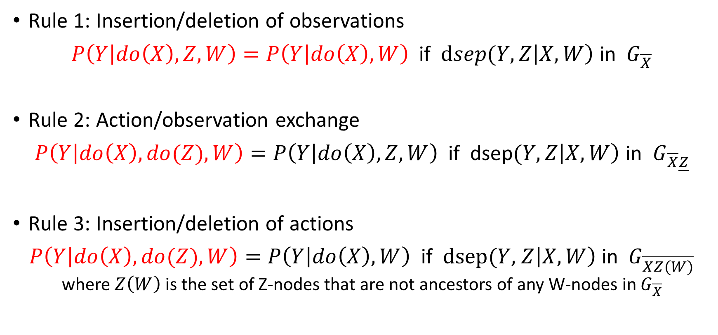
The do-calculus
Rule 1: Insertion/deletion of observations
$P\left(Y | do\left(X\right), Z, W\right)=P\left(Y | do\left(X\right), W\right)$if $dsep(Y,Z\left|X, W\right)$ in $G_{\overline{X}}$
Rule 2: Action/observation exchange
$P\left(Y | do\left(X\right), do(Z), W\right)=P\left(Y | do\left(X\right), Z, W\right)$if dsep$(Y, Z\left|X, W\right)$ in $G_{\overline{X}\underline{Z}}$
Rule 3: Insertion/deletion of actions
$P\left(Y | do\left(X\right), do(Z), W\right)=P\left(Y | do\left(X\right), W\right)$if $dsep(Y,$ $Z\left|X, W\right)$ in $G_{\overline{XZ(W)}}$ where $Z\left(W\right)$ is the set of Z-nodes that are not ancestors of any W-nodes in $G_{\overline{X}}$

Slide 67
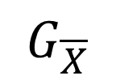

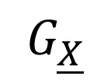
Notation used in the do-calculus
C
C
C
A
A
A
D
D
D
B
B
B
X
Y
X
Y
X
Y
$$G$$
$$G_{\overline{X}}$$
$$G_{\underline{X}}$$
Remove all
edges into X
(manipulated graph)
Remove all
edges out of X

Slide 68
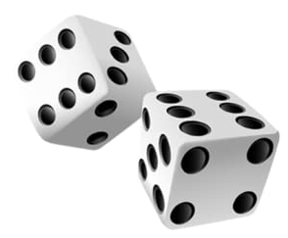
Randomization: do-operator
Gene X
Gene X
RCT
Smoking
COPD
Smoking
COPD
Smoking
COPD
RCT
RCT

Slide 69
Randomization: do-operator
Gene X
Gene X
RCT
Smoking
COPD
Smoking
COPD
Smoking
COPD
RCT
RCT
Remove edges “into” the randomized variable

Slide 70
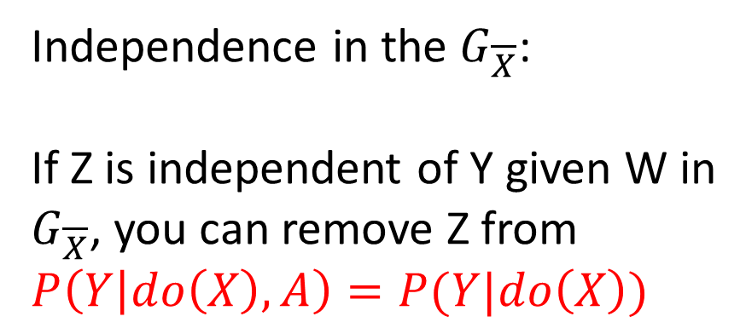
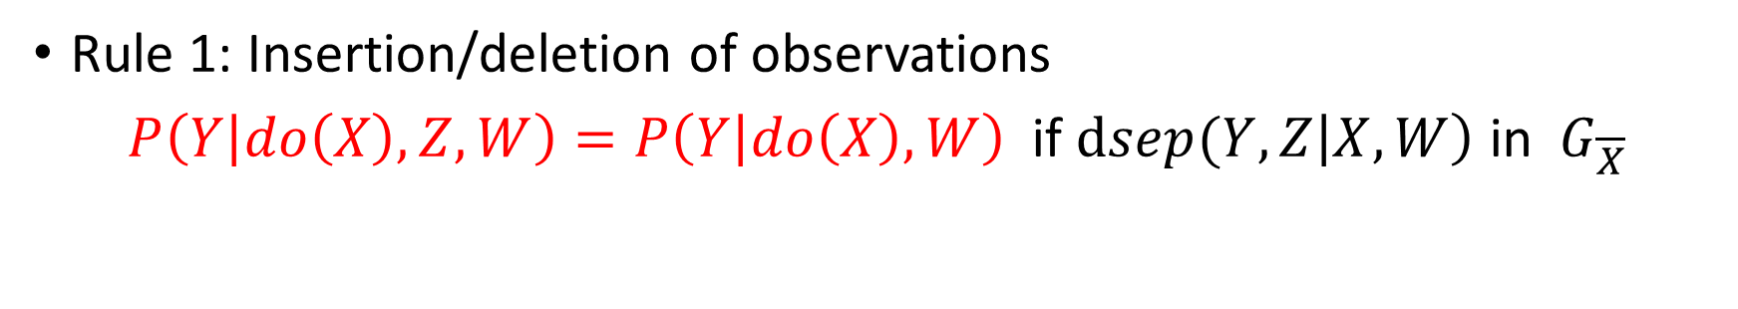
Rule 1: Insert/Delete Observation
Rule 1: Insertion/deletion of observations
$P\left(Y | do\left(X\right), Z, W\right)=P\left(Y | do\left(X\right), W\right)$if $dsep(Y,Z\left|X, W\right)$ in $G_{\overline{X}}$
Independence in the $G_{\overline{X}}$:
If Z is independent of Y given W in $G_{\overline{X}}$, you can remove Z from $P\left(Y | do\left(X\right), A\right)=P(Y|do\left(X\right))$
C
A
D
B
X
Y

Slide 71
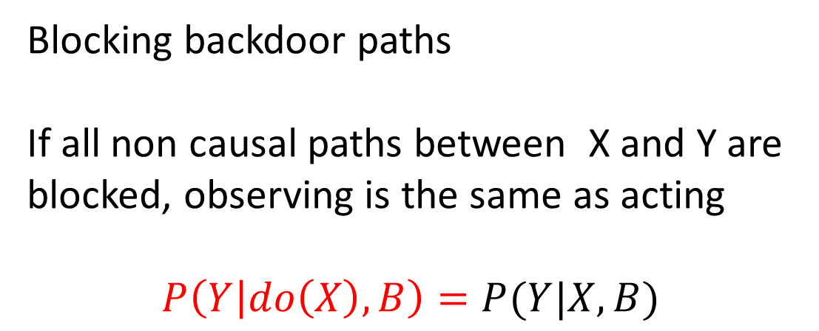
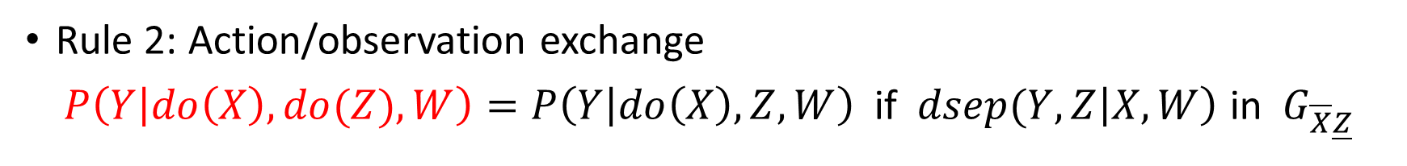
Rule 2: Action/Observation exchange
Rule 2: Action/observation exchange
$P\left(Y | do\left(X\right), do(Z), W\right)=P\left(Y | do\left(X\right), Z, W\right)$if $dsep(Y, Z\left|X, W\right)$ in $G_{\overline{X}\underline{Z}}$
C
Blocking backdoor paths
If all non causal paths between X and Y are blocked, observing is the same as acting
$$P\left(Y | do\left(X\right), B\right)=P(Y|X, B)$$
A
D
B
X
Y

Slide 72
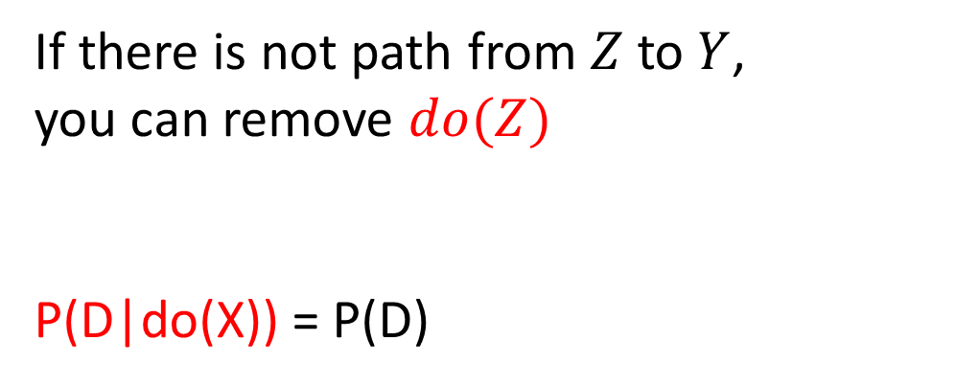
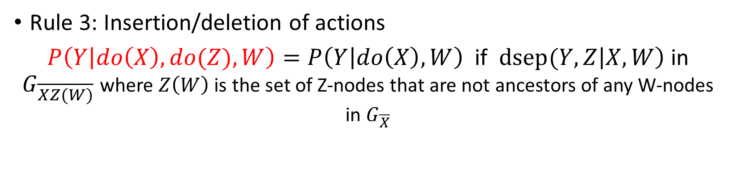
Rule 3: Insert/Delete Action
Rule 3: Insertion/deletion of actions
$P\left(Y | do\left(X\right), do(Z), W\right)=P\left(Y | do\left(X\right), W\right)$if $dsep(Y,Z\left|X, W\right)$ in $G_{\overline{XZ(W)}}$ where $Z\left(W\right)$ is the set of Z-nodes that are not ancestors of any W-nodes in $G_{\overline{X}}$
C
If there is not path from $Z$to $Y$,
you can remove $do(Z)$
P(D|do(X)) = P(D)
A
D
B
X
Y

Slide 73
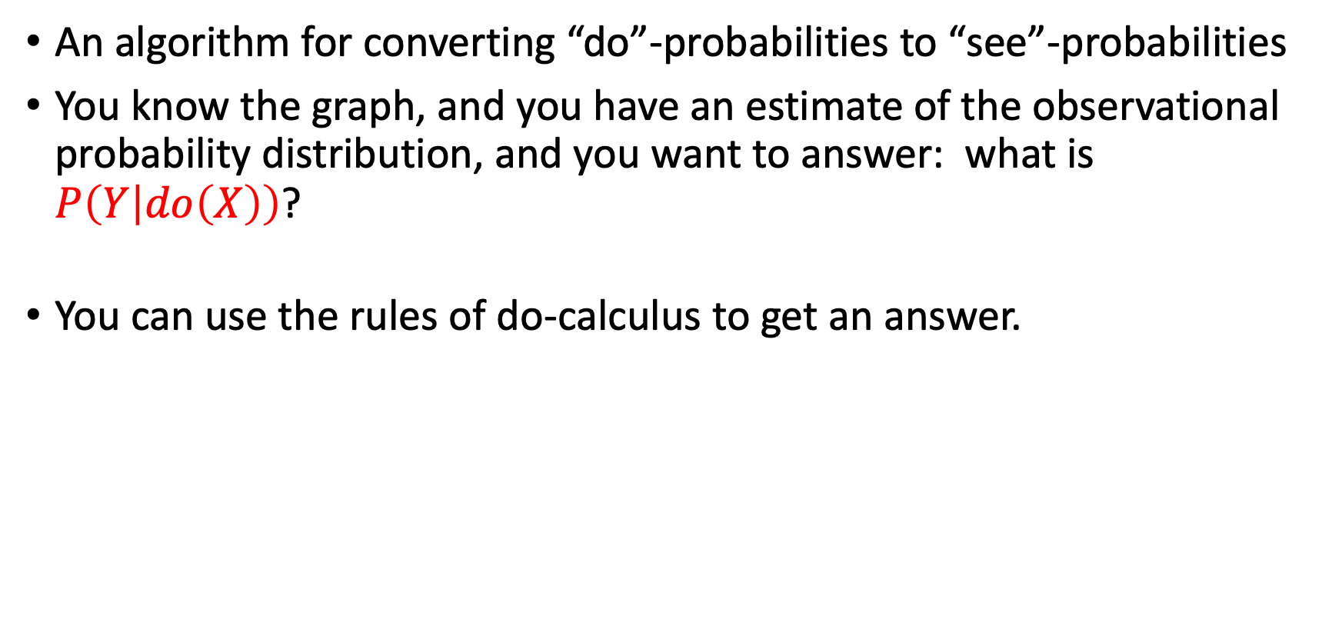
Do-calculus
An algorithm for converting “do”-probabilities to “see”-probabilities
You know the graph, and you have an estimate of the observational probability distribution, and you want to answer: what is $P\left(Y | do\left(X\right)\right)$?
You can use the rules of do-calculus to get an answer.

Slide 74

Do-calculus / Example 1
C
A
D
What is $P\left(Y | do\left(X\right)\right)?$
$$P\left(Y | do\left(X\right)\right)=\sum_{B}{P\left(Y | do\left(X\right), B\right)P(B|do\left(X\right))}$$
B
X
Y

Slide 75



Do-calculus / Example 1
Rule 2:
$$P\left(Y | do\left(X\right), do(Z), W\right)=P\left(Y | do\left(X\right), Z, W\right)$$
if $(Y$ $∥$ $Z\left|X, W\right)$ in $G_{\overline{X}\underline{Z}}$
C
A
What is $P\left(Y | do\left(X\right)\right)?$
$$P\left(Y | do\left(X\right)\right)=\sum_{B}{P\left(Y | do\left(X\right), B\right)P(B|do\left(X\right))}$$
$$P\left(Y | do\left(X\right)\right)=\sum_{B}{P\left(Y | X, B\right)P(B|do\left(X\right))}$$
D
B
X
Y
Rule 2 with
$$Z←X$$
$$X←∅$$
$$W←B$$

Slide 76



Do-calculus / Example 1
Rule 3:
$P\left(Y | do\left(X\right), do(Z), W\right)=P\left(Y | do\left(X\right), W\right)$if $(Y$ $∥$ $Z\left|X, W\right)$ in $G_{\overline{XZ(W)}}$
C
A
What is $P\left(Y | do\left(X\right)\right)?$
$$P\left(Y | do\left(X\right)\right)=\sum_{B}{P\left(Y | do\left(X\right), B\right)P(B|do\left(X\right))}$$
$$P\left(Y | do\left(X\right)\right)=\sum_{B}{P\left(Y | X, B\right)P(B|do\left(X\right))}$$
$$P\left(Y | do\left(X\right)\right)=\sum_{B}{P\left(Y | X, B\right)P(B)}$$
D
B
X
Y
Rule 3 with
$$Z←X$$
$$X←∅$$
$$W←∅$$
$$Y←B$$

Slide 77

Backdoor criterion: estimate the average treatment effect
C
A
What is $P\left(Y | do\left(X\right)\right)?$
$$P\left(Y | do\left(X\right)\right)=\sum_{B}{P\left(Y | do\left(X\right), B\right)P(B|do\left(X\right))}$$
$$P\left(Y | do\left(X\right)\right)=\sum_{B}{P\left(Y | X, B\right)P(B|do\left(X\right))}$$
$$P\left(Y | do\left(X\right)\right)=\sum_{B}{P\left(Y | X, B\right)P(B)}$$
D
B
X
Y
Find a set of pre-treatment covariates that block all backdoor paths, and “adjust” for their influence

Slide 78

Do-calculus / Example 2
Gene
What is $P\left(C | do\left(S\right)\right)?$
$P\left(C | do\left(S\right)\right)=\sum_{t}{P\left(C | do\left(S\right), t\right)P(t|do\left(S\right))}$ [Probability axioms]
= $\sum_{t}{P\left(C | do(S),do(t)\right)P(t|do\left(S\right))}$ [Rule 2: exchange t/do(t)]
= $\sum_{t}{P\left(C | do\left(S\right), do(t)\right)P(t|S)}$ [Rule 2: exchange do(S)/S]
= $\sum_{t}{P\left(C | do(t)\right)P(t|S)}$ [Rule 3: Remove do(S)]
= $\sum_{s′}{\sum_{t}{P\left(C | do\left(t\right),s^{′}\right)P(s^{′}|do\left(t\right))P(t|S)} }$ [Probability axioms]
=$\sum_{s′}{\sum_{t}{P\left(C | t,s^{′}\right)P(s^{′}|do\left(t\right))P(t|S)} }$ [Rule 2: Exchange t/do(t)]
=$\sum_{s′}{\sum_{t}{P\left(C | t,s^{′}\right)P(s^{′})P(t|S)} }$ [Rule 3: Remove do(t)]
Smoking
Tar
Cancer

Slide 79
Do-calculus
Allows us to get post-intervention probabilities from pre-intervention probabilities
Complete for identification of post-intervention probabilities:
If we can identify a post-intervention probability from the pre-intervention probability, we can do this using some combination of do-calculus rules+ the axioms of probability.

Slide 80

Things you can do with a Causal Bayesian Network
Factorize the joint probability distribution.
Answer questions like:
What is the probability of getting CVD if I have high levels of Protein X?
P(CVD| Levels of Protein X=high ) = ?
Is Smoking independent from Fatigue given Levels of Protein X?
$\text{Smoking}∥\text{Fatigue}\text{|}\text{Levels} \text{of} \text{Protein} \text{X}\text{?}$
Will I reduce the probability of getting CVD if I design a drug that lowers the levels of protein X?
P(CVD|do(Levels of Protein X=low))?
Smoking
Medicine Y
Yellow
Teeth
Levels of Protein X
CVD
Fatigue

